Slide 1


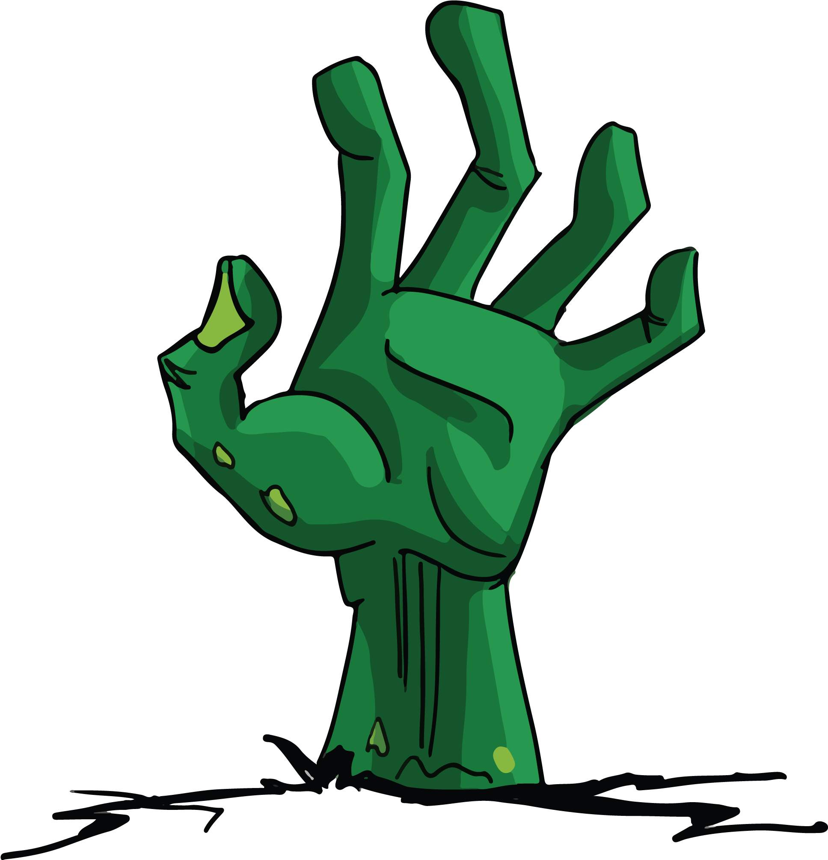
Necro Nursery
Team Abra-cadaver

Slide 2
Narrative
Started writing new World Bible iteration with changes
Updated Dialogue for the Merchant
Compiled Dialogue in one location

Slide 3
Audio
Not much to report, just finishing up the new songs
Mastermind
Brewing
Trying to get as much done as possible before I go so the team doesn’t need to do much audio

Slide 4
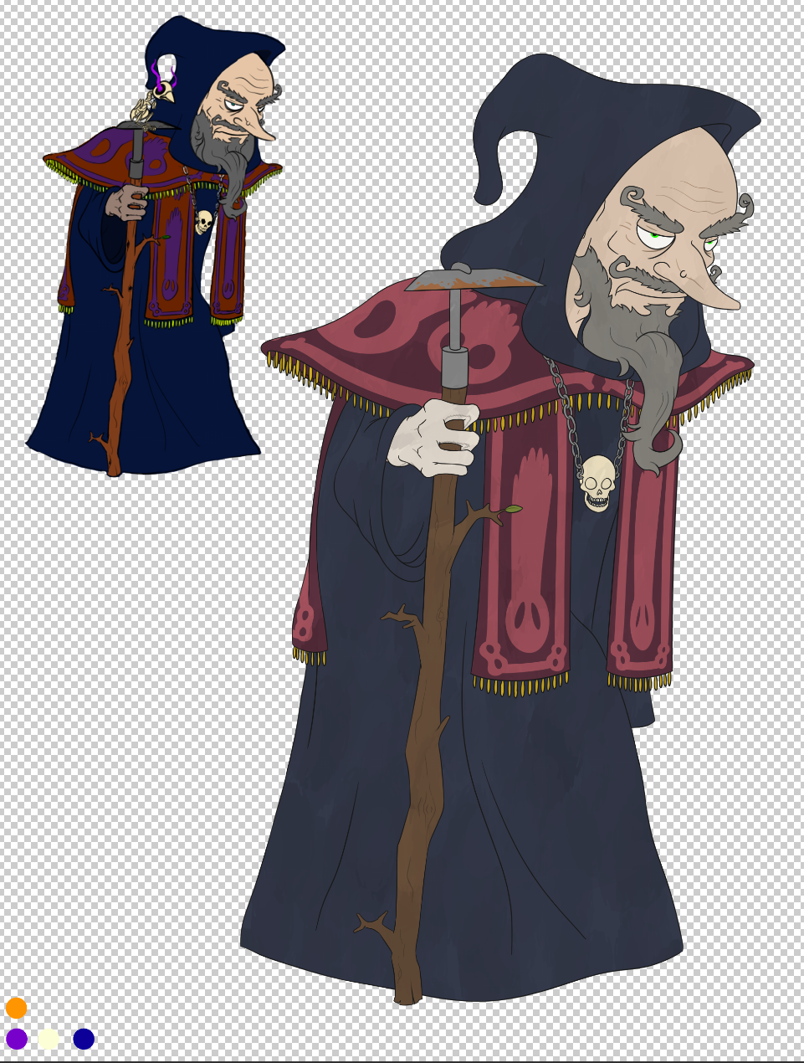
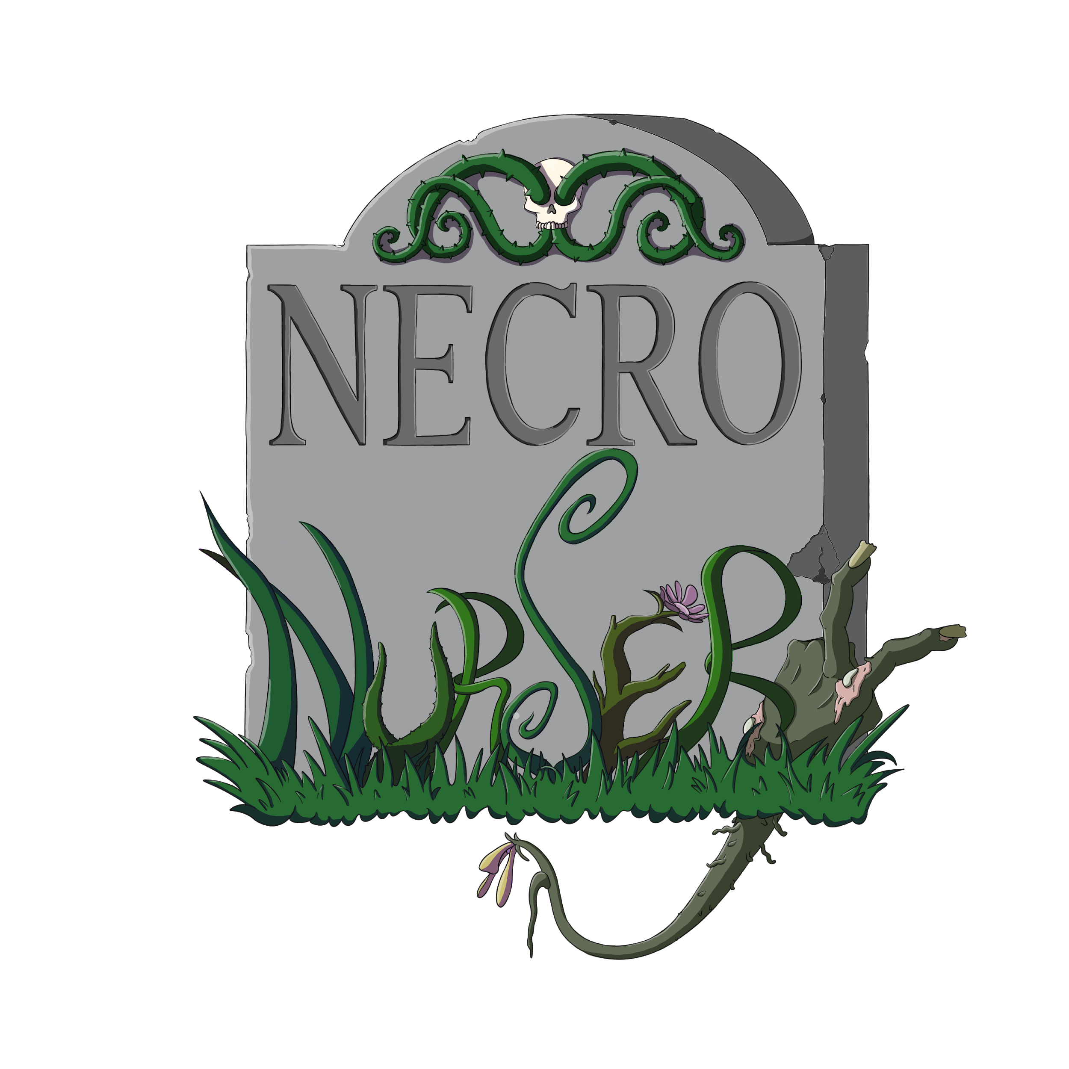
W I P

Slide 5
Programming
Summoning Master Minigame
Rune placement
Generates random “correct code”
Checks player input
TODO - track prev guesses and changes left
Brewing Minigame
Cauldron collision
Objects duplicate when moved
Tile flipping to reveal needed ingredient
Boxes to indicate if your guess was correct or not
Tutorial
Minor fixes - needs more
Marketplace
Dialogue Display

Slide 6
Troubles along the way?
Vision miscommunication issues (still)
Fighting low motivation (end of semester)

Slide 7
What we plan to do!
Clean up tutorial
Playtest minigames as needed
Make sure game has minimal bugs for final

Slide 8
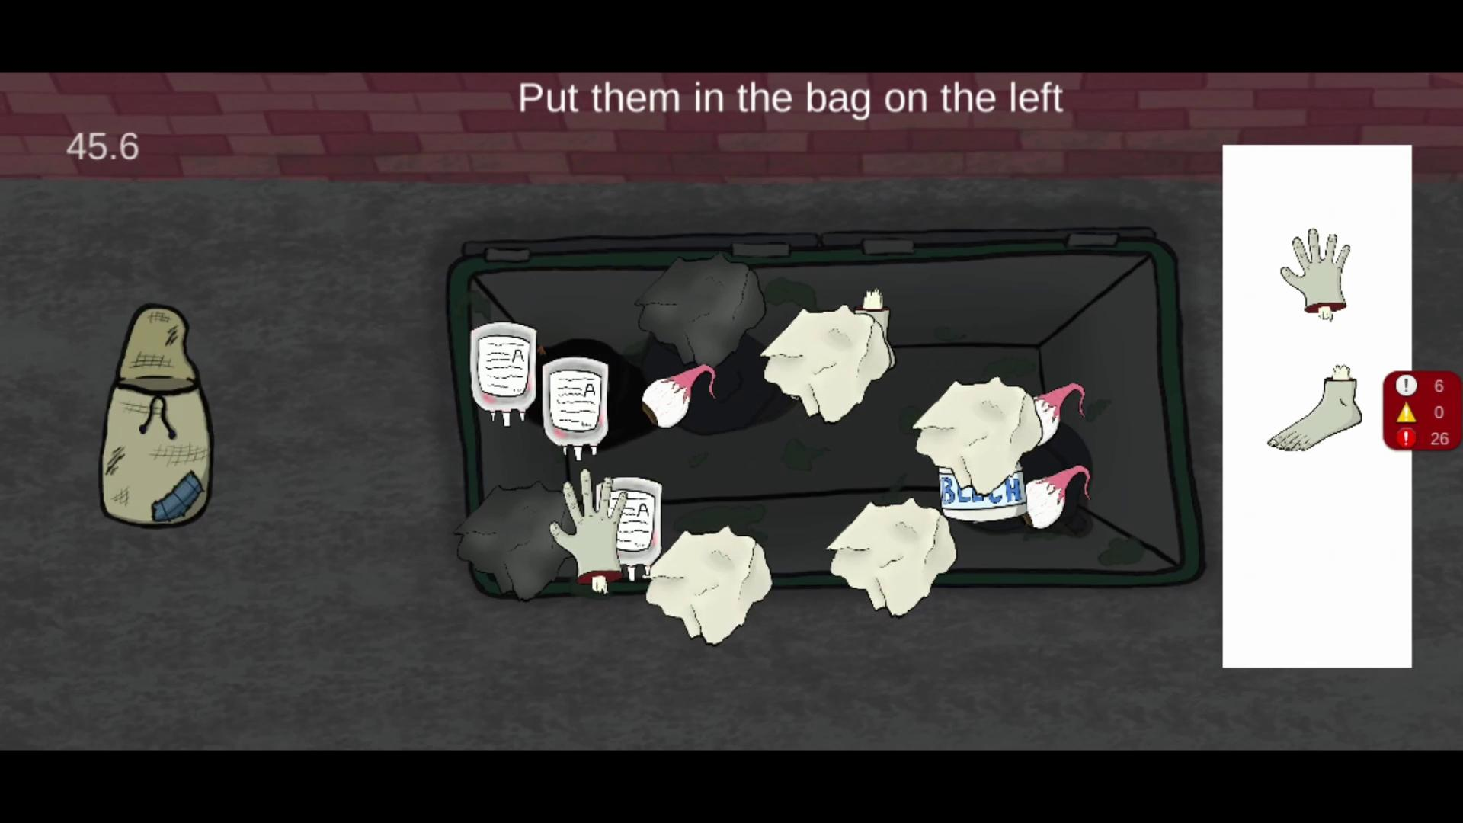
Gameplay

Slide 9
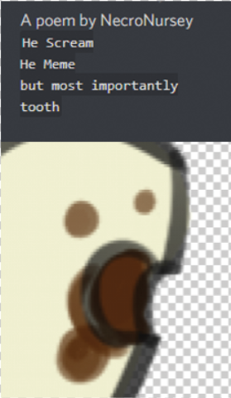
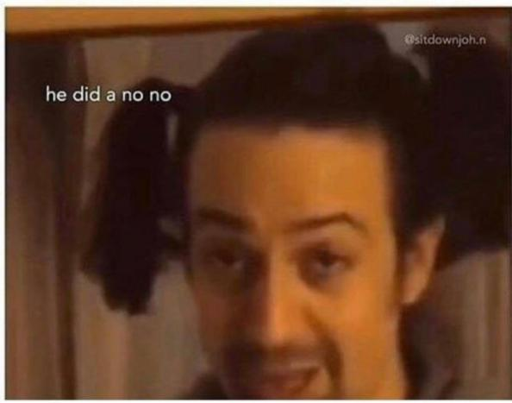
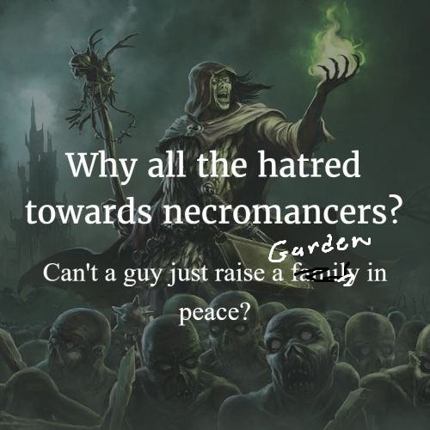

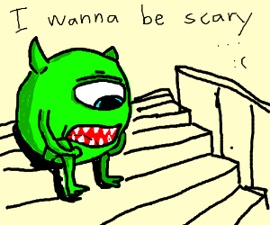
Questions?

